Slide 1
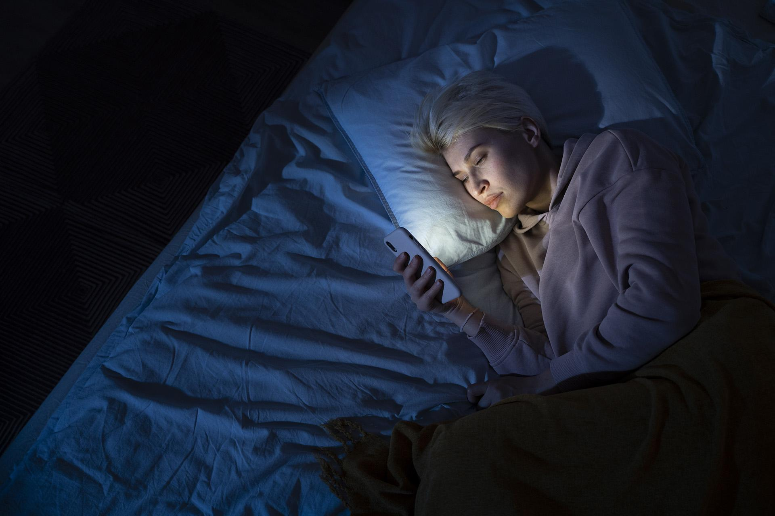
Insomnia
Freya Ma, MS
Jane Han, ME
Joseph Nano, MPH
QBS 181 2023 Fall

Slide 2
Table of contents
01
02
03
04
05
Introduction
Methods
Results
Discussion
Acknowledgments

Slide 3

01
Introduction

Slide 4

Sleep
A fundamental necessity of life.
Sleep loss impairs task performance, cognitive performance, and mood ¹ :
CDC declared that insufficient sleep is a public health epidemic ²
Self-reported short sleep duration in the United States varies by industry and occupation, and has increased over the past two decades ³

Slide 5
Introduction Part I
Background
Importance
According to several studies, more than half of healthcare professionals report symptoms of burnout, insomnia, depression, anxiety, and mental health illnesses ^{4,5}
Some studies have shown race and ethnic disparities in sleep patterns in the United States ⁶

Slide 6
Introduction Part II
Adolescence
Clinical findings
Sleep duration varies across the human lifespan and the ideal amount of sleep recommended each night may vary due to genetic factors ⁷
Some studies have shown an inverse relationship between sleep with age and insufficient sleep has become widespread, especially among adolescents ^{7,8}

Slide 7
Purpose of the Study
Objective: Our study aimed to investigate the association between sleep and other covariates in adolescent population, and will highlight the consequences of sleep insomnia on mental health.
Aim 1: Visualization of insomnia symptomatology in adolescents by insomnia vs control groups
Aim 2: Statistical analysis to investigate the relationship of sleep quality and habits in adolescents

Slide 8
02
Methods

Slide 9
[Part 1] Data Description
Methods
Dataset
Variables of interest
Open database: part of a larger study funded by the National Heart, Lung and Blood Institute investigating the pathophysiology of insomnia in adolescence.
1. ‘Age’ among adolescents
2. Race(‘White’ & ‘Asian’)
3. Adolescent Sleep Hygiene Scale
4. Insomnia Severity Index (ISI)
5. Depression Index (BDI)

Slide 10
[Aim 1] Visualization of data exploration
Methods
Goal 1
Goal 2
Identify distinct subgroups among adolescents based on demographic variables
Perform correlation statistical analysis on sleep quality and habits in Adolescents

Slide 11
[Aim 2] Relationship of sleep quality and habits
Methods
Goal 1
Goal 2
Use sleep quality to predict mental health and habits among adolescents with regression analyses
Investigate if the interaction effect of significant predictor factor(s) above and the race factor is statistically significant.

Slide 12
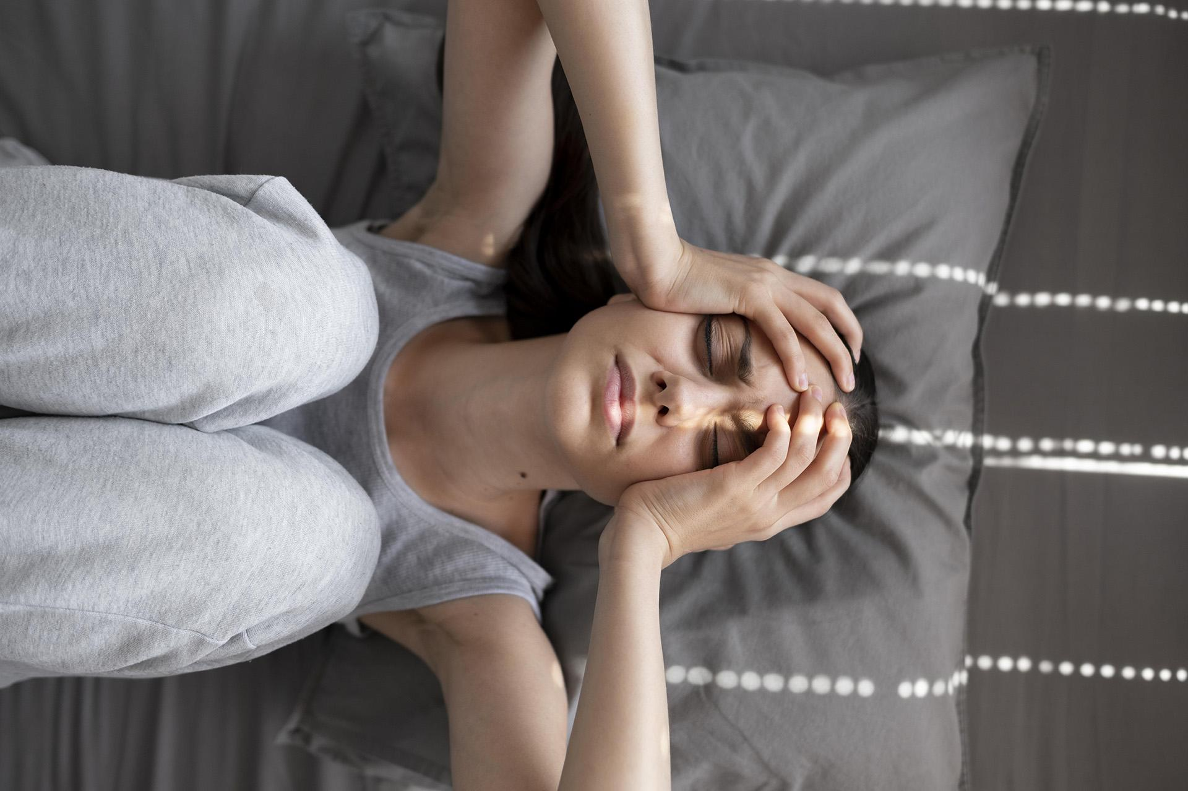
03
Results

Slide 13
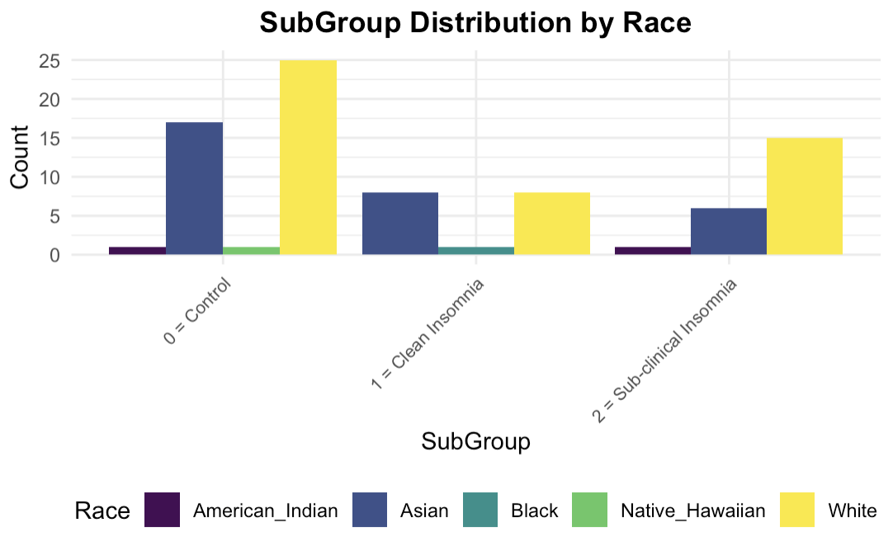
[Preliminary Steps] Sub group Distribution by Race
Results
0 = Control: Individuals who do not have insomnia.
1 = Clean Insomnia: Individuals who meet all the criteria for a diagnosis of insomnia without having other complicating factors or conditions.
2 = Sub-clinical Insomnia: Individuals who have symptoms of insomnia, but these symptoms do not meet the full diagnostic criteria for clinical insomnia.
Notes:
1 = Clean Insomnia: (Example) individuals who have sleep issues that are not caused by another mental health condition, medication, or a medical problem

Slide 14
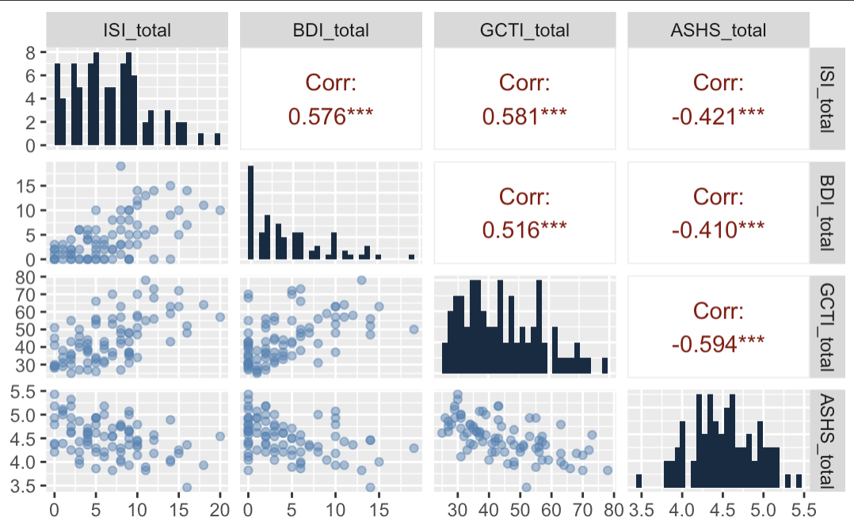
[Aim 1.1] Correlation tests among Insomnia, Depression, Thoughts, and Sleep Hygiene
Results
ISI_total Insomnia Severity Index
BDI_total Depression Index (Becks Inventory)
GCTI_total Thoughts Inventory (e.g., anxiety, reflection, worries, thoughts, negative Affect)
ASHS_total Sleep Hygiene Scale (e.g., Sleep Environment, Substances, bedtime routine)
Notes:
o Positive Correlations: (For example) As the level of depression increases, the severity of Insomnia will also increase.
o Negative Correlations: (For example) As the level of depression increases, the adolescent sleep hygiene scale (sleep environment, the use of substances, bedtime routines) will decrease.
o In summary, insomnia, depression, as well as the thoughts inventory all have positive correlations, whereas the ASHS_total score (physiological factors) has negative correlations with all three other variables.

Slide 15
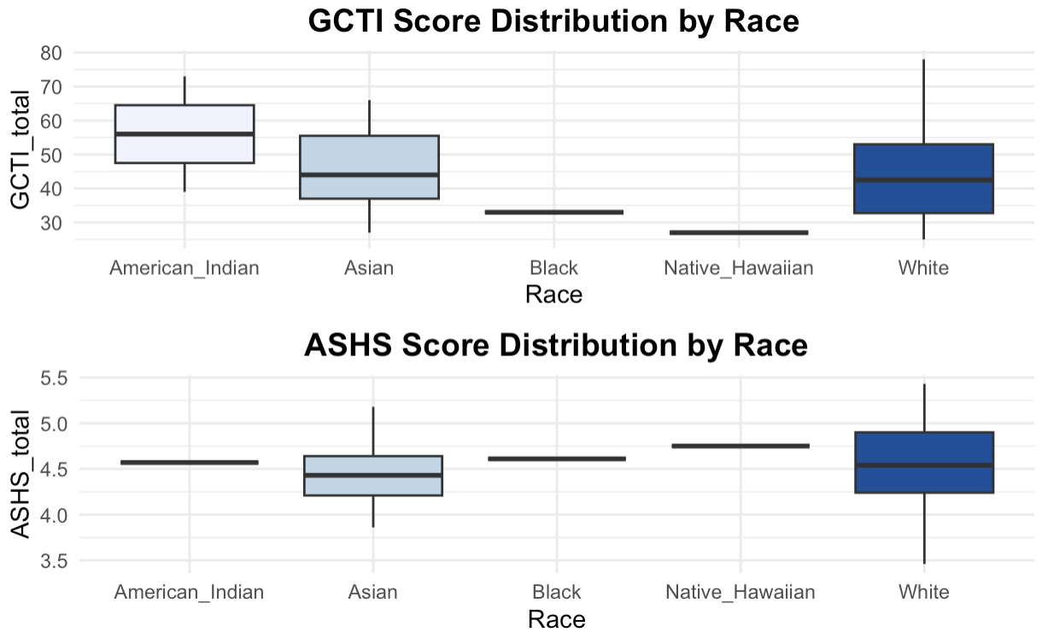
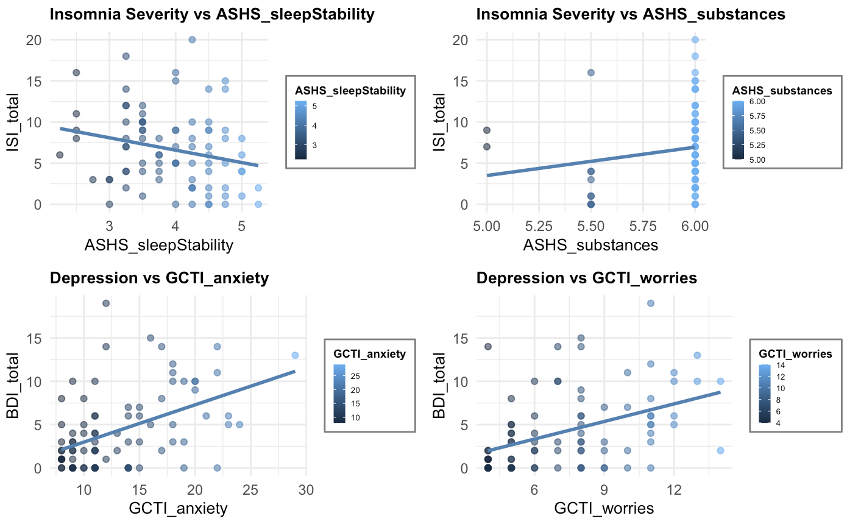
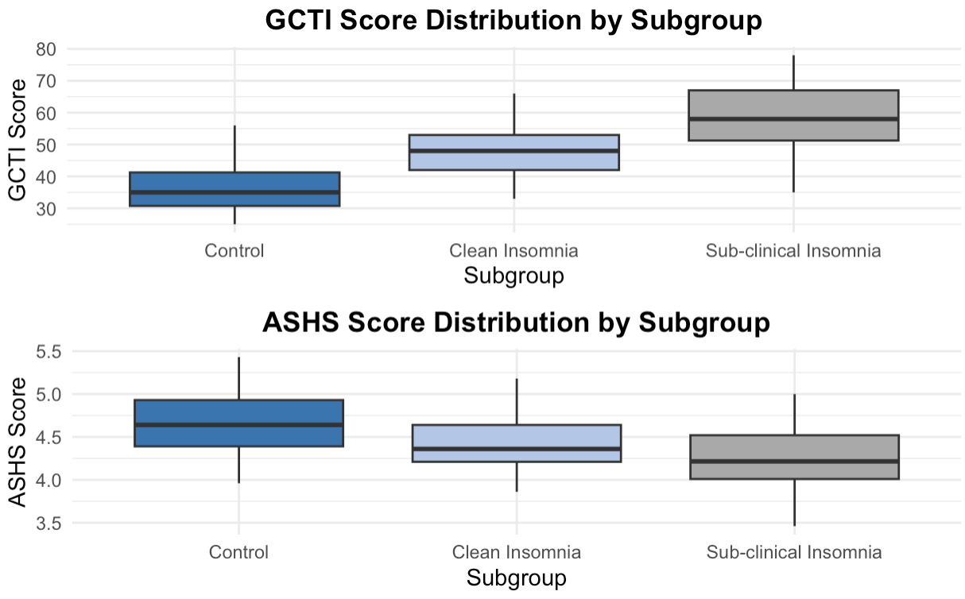
[Aim 1.1] Sub-scale correlation tests and Distribution by Race & Subgroups
Results
Sub Group 2: More severe cognitive impacts or a greater need for cognitive therapy.
Notes:
Boxplots:
For the distribution by subgroup plot, ‘Sub-clinical Insomnia (Sub group 2)’ has the highest median score for thoughts inventory factors, which might imply more severe cognitive impacts or a greater need for cognitive therapy.
For the sleep hygiene factors however, it is the other way around. We will go over what they each mean more in depth in our discussion section.

Slide 16
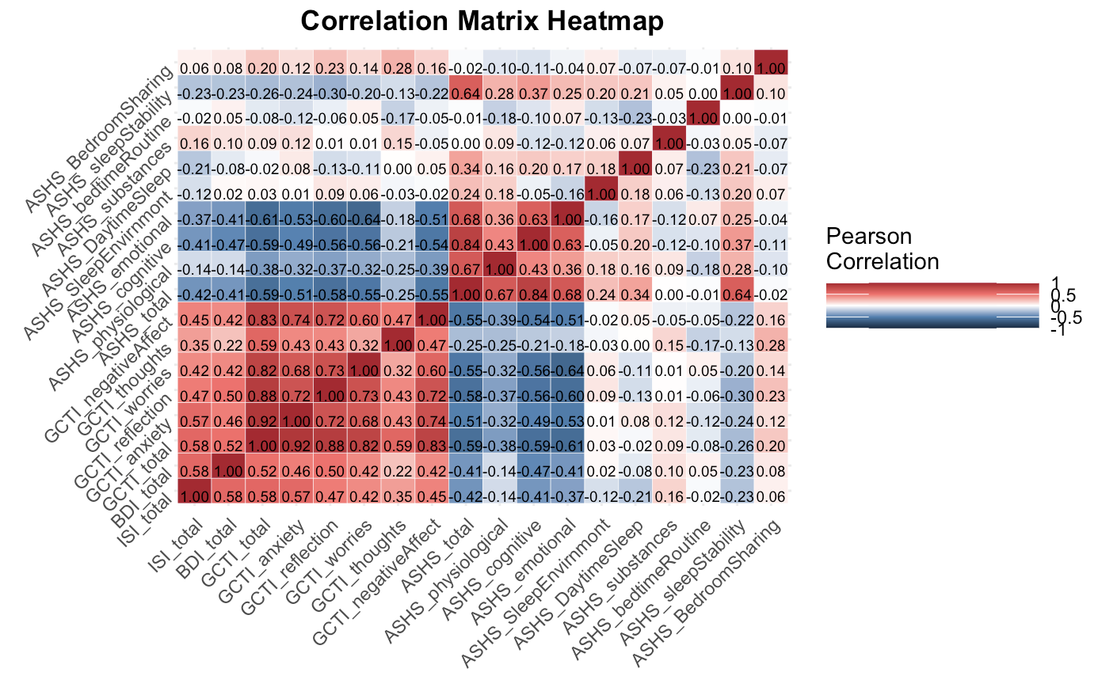
[Aim 1.2] Correlation Matrix Heatmap
Results
Positive correlations suggest a relationship between cognitive and hypnosis-related factors and the severity of insomnia symptoms. Negative correlations suggest that as the level of sleep hygiene scale increases, the severity of insomnia decreases.
Notes:
Key findings:
o There are relatively strong positive correlations between the insomnia severity index and the depression index, as well as the thoughts inventory factors such as anxiety, reflection, and negative affect. This finding suggests a relationship between cognitive and hypnosis-related factors and the severity of insomnia symptoms.
o Sleep hygiene factors (except for the use of substances) however, are mostly negatively correlated with the severity of insomnia, which suggests that as the level of sleep stability, bedtime routine increases, the severity of insomnia decreases.

Slide 17
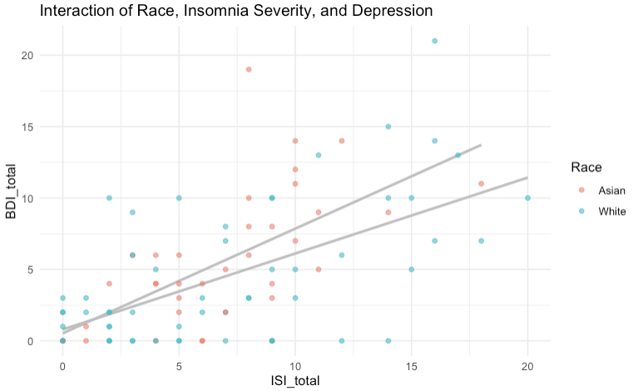
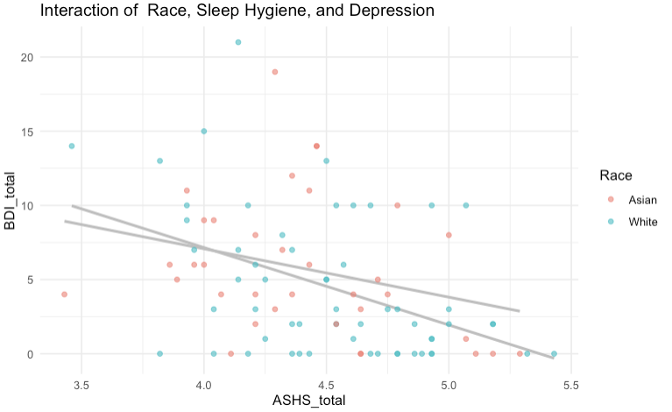
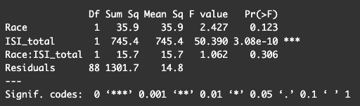
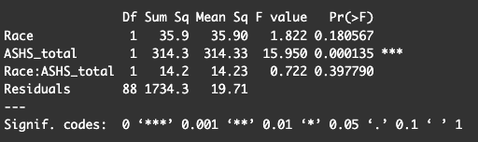
[Aim 2.1] Predicting depression based on insomnia and sleep hygiene
Results
Asian
White
Asian
White
Race effect was not significant, while the insomnia severity level and sleep hygiene were significantly correlated with depression level.
Notes:
Df Sum Sq Mean Sq F value Pr(>F)
Race 1 1.2 1.2 0.080 0.778
GCTI_total 1 885.9 885.9 58.068 2.75e-11 ***
Race:GCTI_total 1 15.1 15.1 0.991 0.322
Residuals 88 1342.6 15.3
---
Signif. codes: 0 ‘***’ 0.001 ‘**’ 0.01 ‘*’ 0.05 ‘.’ 0.1 ‘ ’ 1

Slide 18
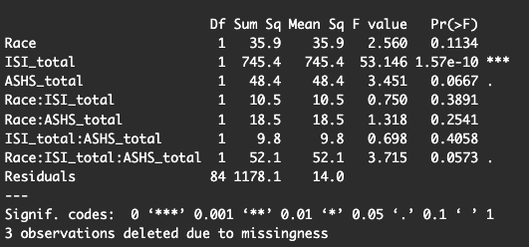
[Aim 2.2] Interaction of depression, insomnia, sleep hygiene, & race
Results
Again, the race did not correlate with other sleep factors
It is interesting to note that three way interaction effect were marginally significant.

Slide 19
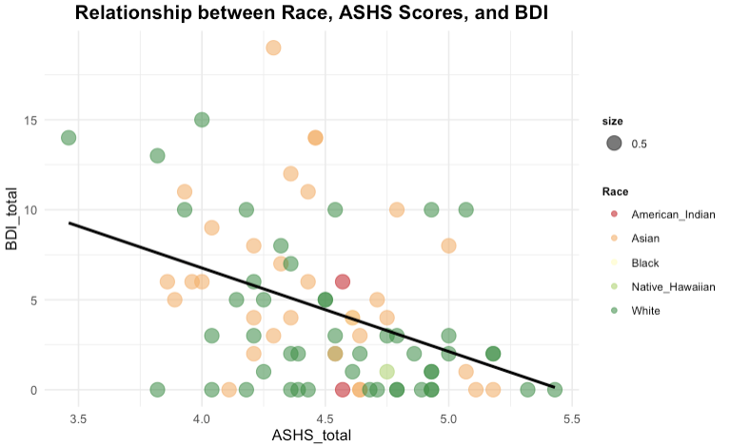
[3 way interaction] Race, ASHS, BDI

Slide 20
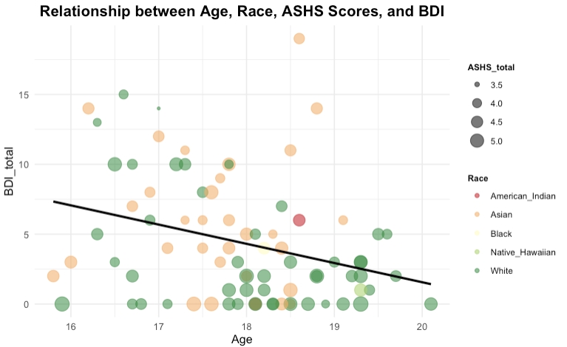
[4 way interaction] Age, BDI, ASHS, and Race

Slide 21
Discussion Part I
Key findings
As the severity of insomnia increases, depression levels also increase
As the level of thoughts inventory factors (e.g., anxiety, worries, negative affect) increases, the severity of insomnia also increases
Results in context
Previous studies have shown that treating insomnia decreases severity of depression ⁸
Studies have shown that treatments such as non-benzodiazepines are effective in decreasing anxiety and increasing sleeping hours ⁹
Cognitive behavioral therapy for insomnia has been shown effective during adolescence and young adulthood ¹⁰
Implications / Conclusion
Adolescents with insomnia are more likely to experience depressive symptoms. Future studies may investigate this association during adulthood

Slide 22
Discussion Part II
Limitations
We cannot generalize the results from a sample to the US population because of the small sample size
Insomnia Severity Index may not be the most accurate measure for insomnia
Conclusion
Adolescents with insomnia are more likely to experience depressive symptoms.

Slide 23


Thank you!
Acknowledgments
Carly, Ashlee, Gauri —

Slide 24
Questions? & possible Answers!

Slide 25
References
Troynikov O, Watson CG, Nawaz N. Sleep environments and sleep physiology: A review. J Therm Biol. 2018;78:192-203. doi:10.1016/j.jtherbio.2018.09.012
Liu Y, Wheaton AG, Chapman DP, Cunningham TJ, Lu H, Croft JB. Prevalence of Healthy Sleep Duration among Adults--United States, 2014. MMWR Morb Mortal Wkly Rep. 2016;65(6):137-141. Published 2016 Feb 19. doi:10.15585/mmwr.mm6506a1
Luckhaupt SE, Tak S, Calvert GM. The prevalence of short sleep duration by industry and occupation in the National Health Interview Survey. Sleep. 2010;33(2):149-159. doi:10.1093/sleep/33.2.149
Prasad K, McLoughlin C, Stillman M, et al. Prevalence and correlates of stress and burnout among U.S. healthcare workers during the COVID-19 pandemic: a national cross-sectional survey study. EClinicalMedicine 2021;35:100879-100879.
Bryant-Genevier J, Rao CY, Lopes-Cardozo B, et al. Symptoms of depression, anxiety, post- traumatic stress disorder, and suicidal ideation among state, tribal, local, and territorial public health workers during the COVID-19 pandemic — United States, March–April 2021. MMWR Morb Mortal Wkly Rep 2021;70:1680-1685.
Johnson DA, Jackson CL, Williams NJ, Alcántara C. Are sleep patterns influenced by race/ethnicity - a marker of relative advantage or disadvantage? Evidence to date. Nat Sci Sleep. 2019;11:79-95. Published 2019 Jul 23. doi:10.2147/NSS.S169312
Chaput JP, Dutil C, Sampasa-Kanyinga H. Sleeping hours: what is the ideal number and how does age impact this?. Nat Sci Sleep. 2018;10:421-430. Published 2018 Nov 27. doi:10.2147/NSS.S163071

Slide 26
References
8. Gebara MA, Siripong N, DiNapoli EA, et al. Effect of insomnia treatments on depression: A systematic review and
meta-analysis. Depress Anxiety. 2018;35(8):717-731. doi:10.1002/da.22776
9. Troynikov O, Watson CG, Nawaz N. Sleep environments and sleep physiology: A review. J Therm Biol.
2018;78:192-203. doi:10.1016/j.jtherbio.2018.09.012
10. Chan WS, McCrae CS, Ng AS. Is Cognitive Behavioral Therapy for Insomnia Effective for Improving Sleep Duration in
Individuals with Insomnia? A Meta-Analysis of Randomized Controlled Trials. Ann Behav Med. 2023;57(6):428-441.
doi:10.1093/abm/kaac061

